Slide 1

Inheritance

Slide 2
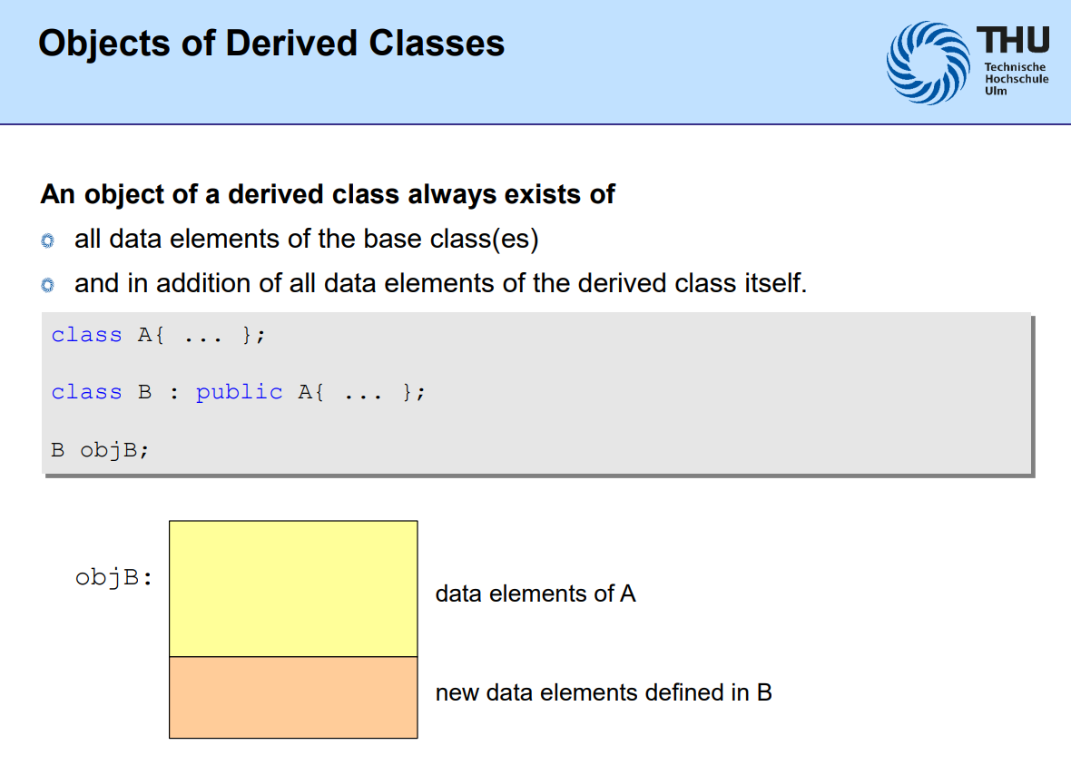
What is Interitance
In simple terms, inheritance in C++ is a way for one class (called a derived class) to get or "inherit" properties and behaviours (like variables and functions) from another class (called a base class).

Slide 3
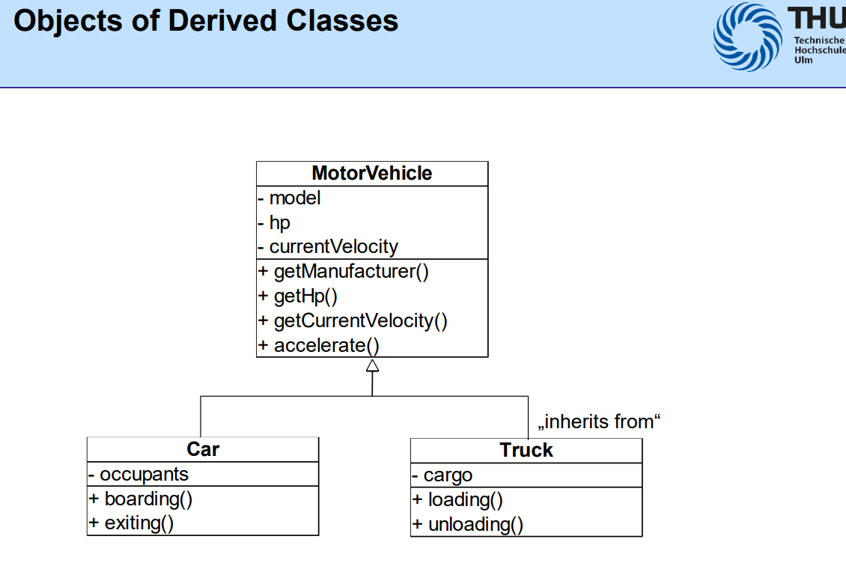
Notes:
1. Child classes (`Car`, `Truck`) can reuse **public methods and variables** from the base class (`MotorVehicle`).
2. Private members (marked with `-`) in `MotorVehicle` cannot be accessed directly by child classes.
3. Public members (marked with `+`) are accessible to child classes.
4. Protected members (not shown, but would use `#`) are accessible to child classes but hidden from outside classes.

Slide 4
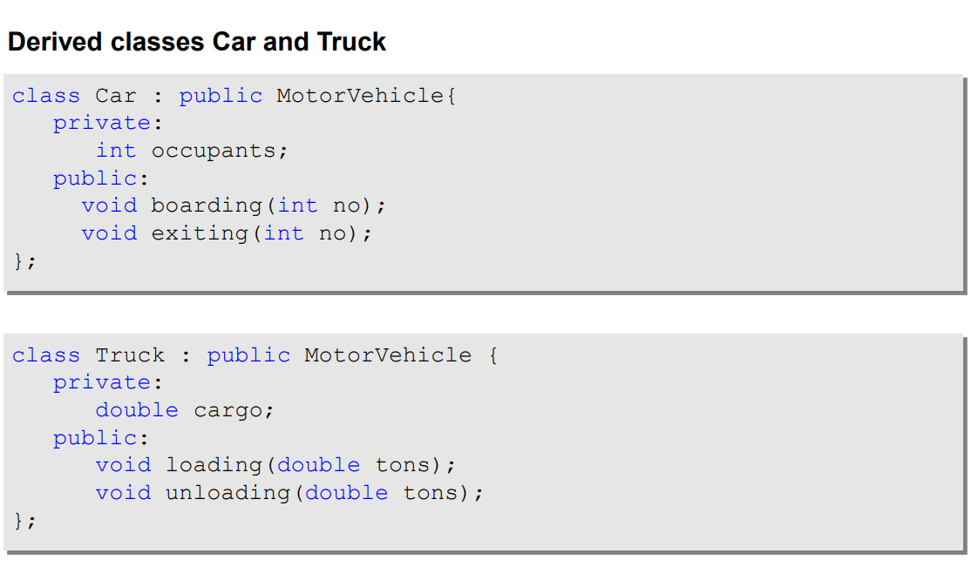

Slide 5
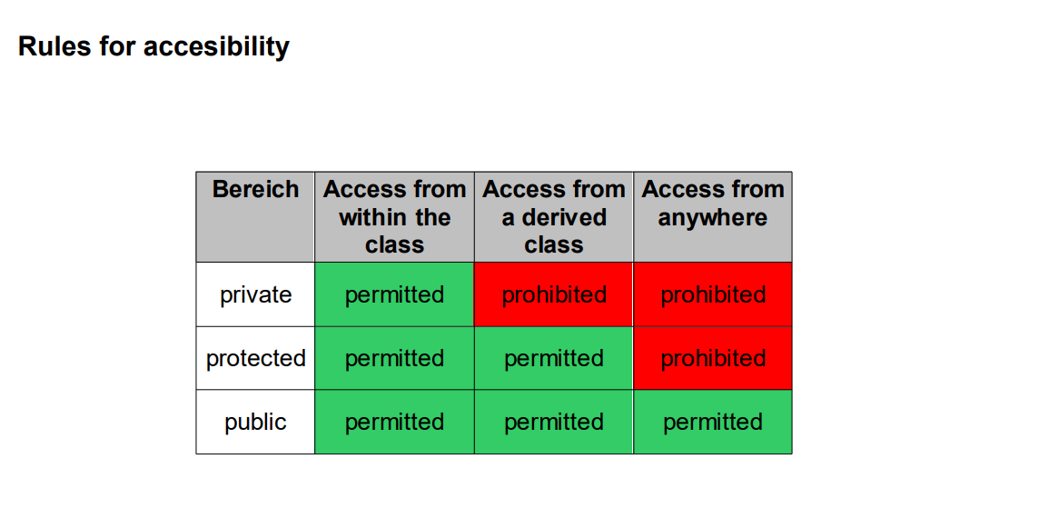
Another Important Slide

Slide 6
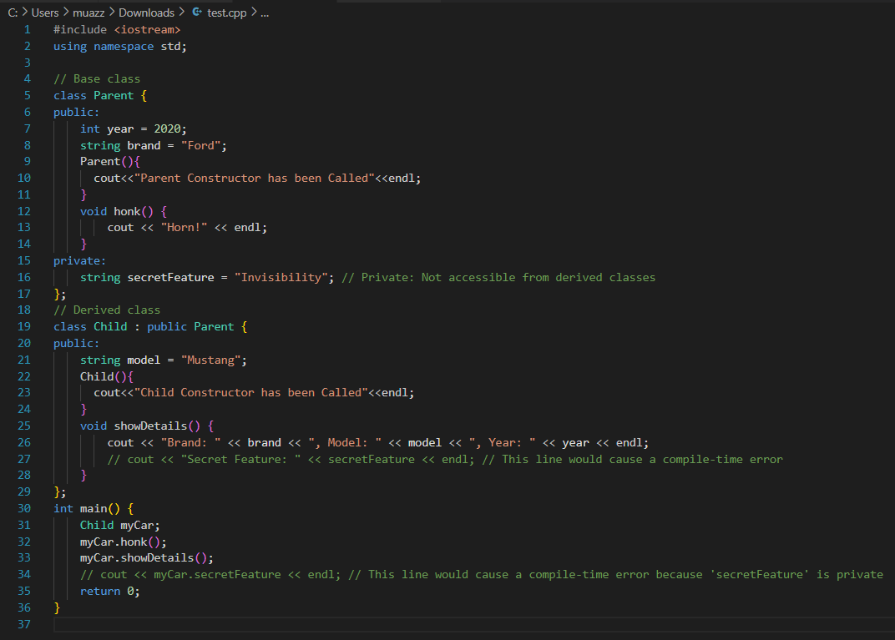


Slide 7
Exam Tips
A derived class constructor automatically calls the default constructor of the base class before executing the code of the constructor itself!
Precedence
First, the base class constructor is executed.
Second, member objects of the derived class are initialized.
Third, the derived class constructor runs.

Slide 8
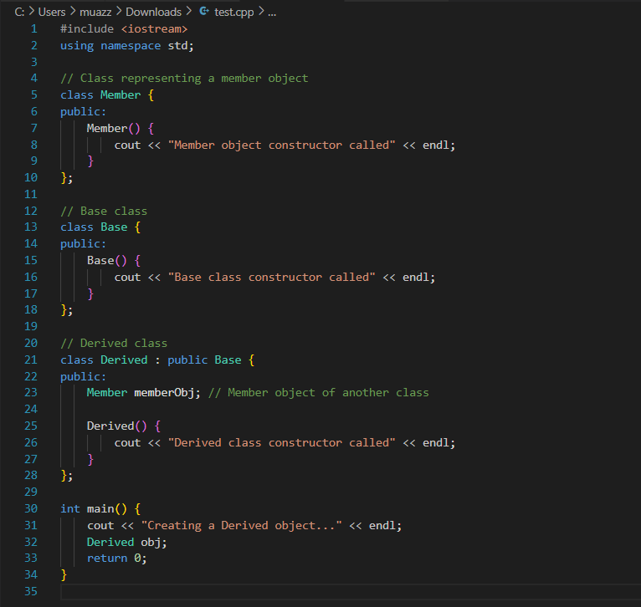


Slide 9
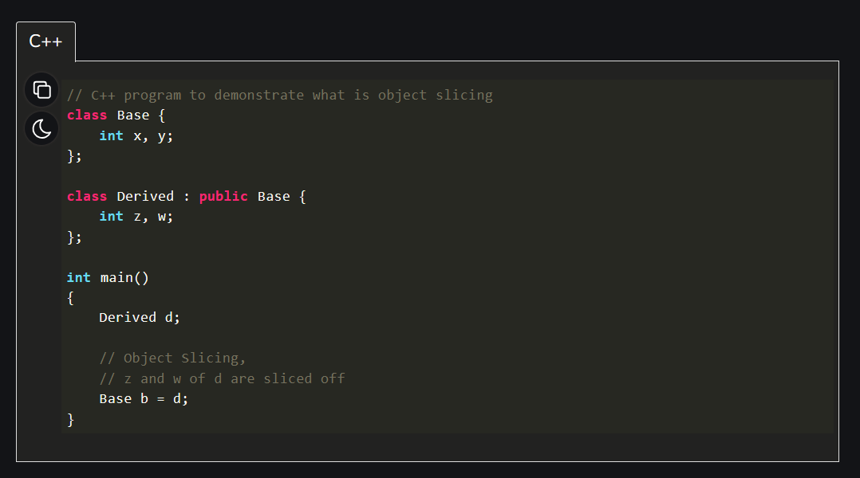
Object Slicing

Slide 10
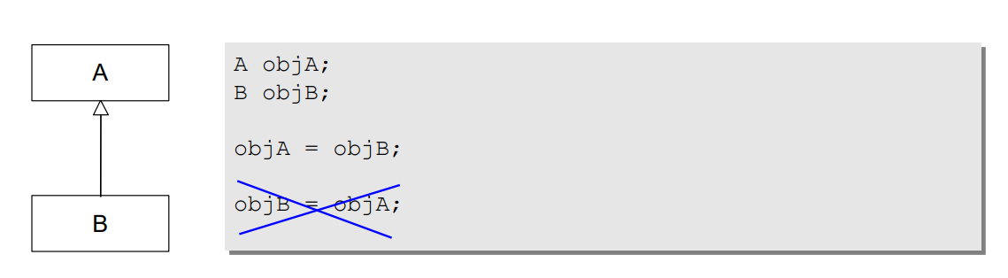
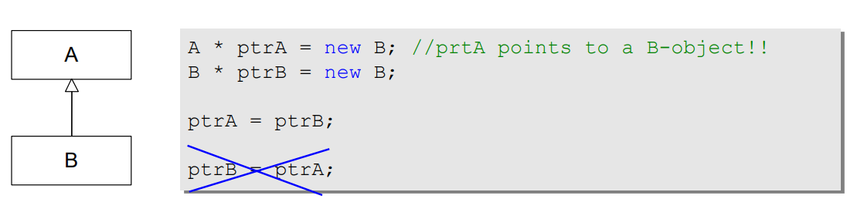
Basic rule for allocation (so-called "slicing")
An object of a derived class may be assigned to an object of a direct or indirect base class (but not the other way round!).
In the assignment, only the elements of the base class are copied component by component

Slide 11
Some Additional Rules
Constructors are not inherited!
A derived class constructor automatically calls the default constructor of the base class before executing the code of the constructor itself!

Slide 12
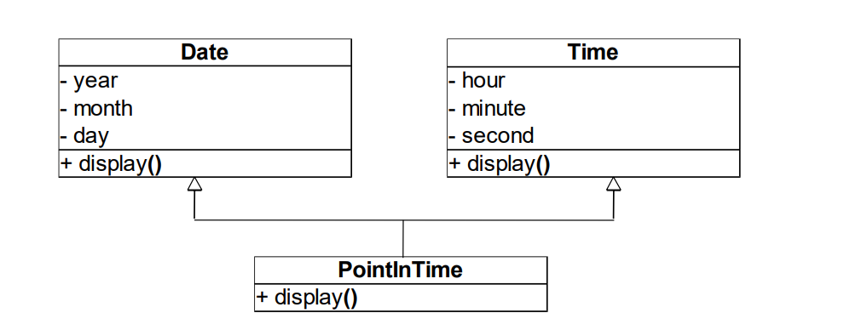
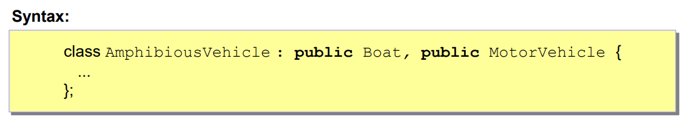
Multiple Interitance

Slide 13
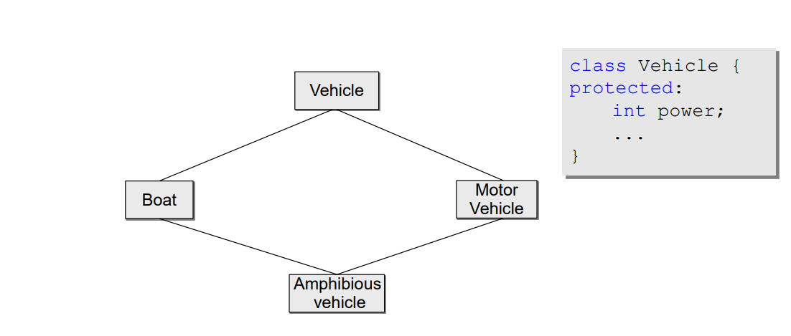
The famous Diamond Problem
Notes:
The issue arises when AmphibiousVehicle inherits from both Boat and Motor Vehicle, because both of these classes inherited from the same base class, Vehicle. Therefore, AmphibiousVehicle ends up inheriting the Vehicle class twice (once via Boat and once via Motor Vehicle), which creates ambiguity.
For instance, if the Vehicle class contains a protected variable, like int power, it's unclear which copy of the variable AmphibiousVehicle should use:
The one from Boat's copy of Vehicle?
Or the one from Motor Vehicle's copy of Vehicle?
C++: It allows multiple inheritance but provides a solution to this problem using virtual inheritance, where the base class (Vehicle) is only inherited once, no matter how many classes inherit from it.

